Slide 1

Use Cases
Zaynab Mourtada, Soham Naik, Deniz Ackibas, Alan Raj
10/11/24

Slide 2
OUTLINE
What we did last week
Read RoFin Research Paper
Reviewed given code
Determined Use Cases
What problems we had & What we learned
Problem: In determining how many use cases there should be.
Solution: We determined the use cases based on how many components there are to the project.
What we plan to do next week
Thoroughly research all of our roles.
Finalize the use cases

Slide 3
What we did last week

Slide 4
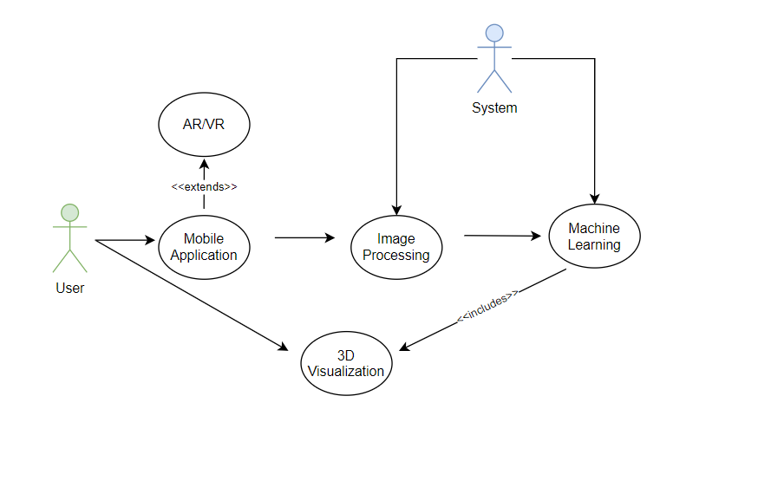
High Level Use Case Diagram
credit / paper reference / source / other info

Slide 5

Q & A THANK YOU

